Slide 1

Be sure to have your supply kit.
Small American Flag
Pre-made signs with your precinct number that you can draw arrows on
Pieces of paper or index cards – for ballots
Pencils/black or blue ink pens/permanent markers/dry erase markers
Nametags for those eligible and credentialed to vote
Visitor nametags for non eligible voters
6 – 8 sheets jumbo size kraft paper
Container to place ballots in (Optional)
Sticky notes
Paper clips
Blank paper
Clipboard
Stopwatch
Large Ziplock bags or envelopes to place used ballots in – ALL USED BALLOTS MUST BE RETURNED

Slide 2
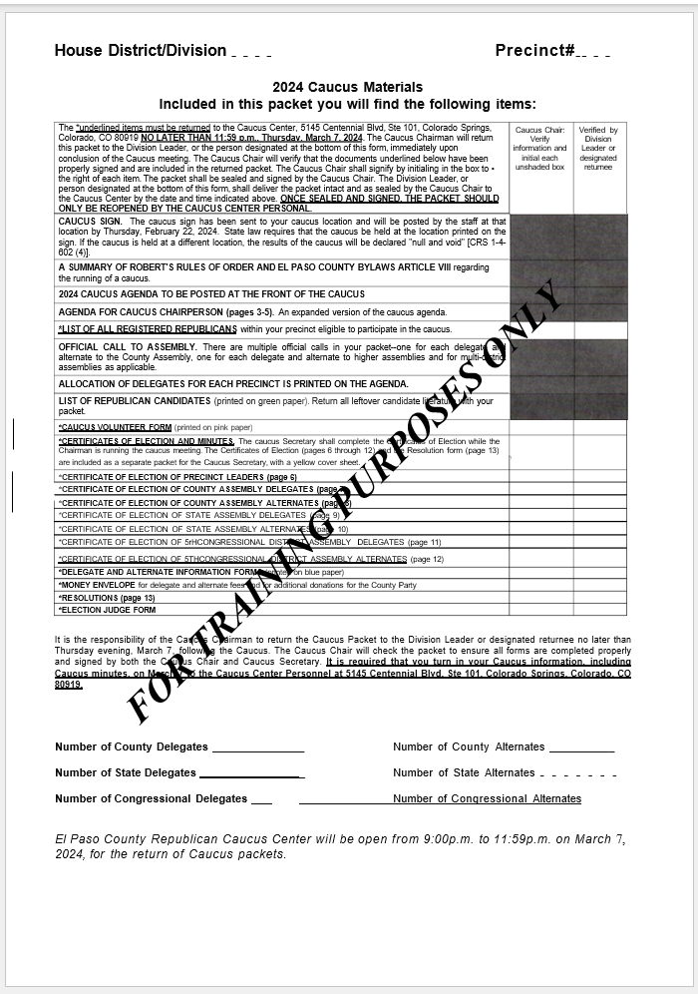
Getting Started
Conduct an inventory of the contents of your precinct Caucus packet.
Use page 1 of the
Precinct Caucus
Script (Green packet).

Slide 3
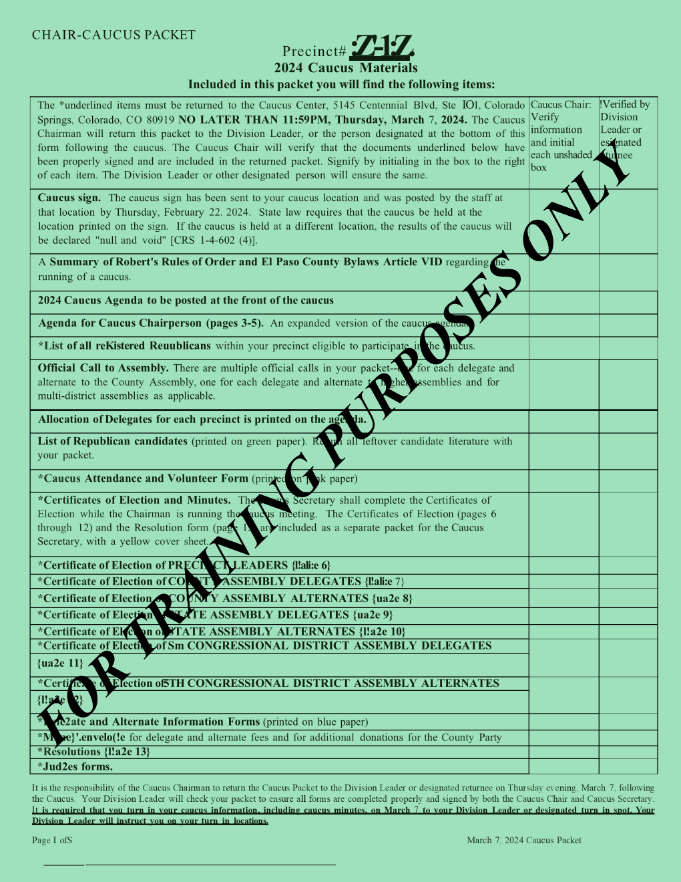
Packet Contents

Slide 4
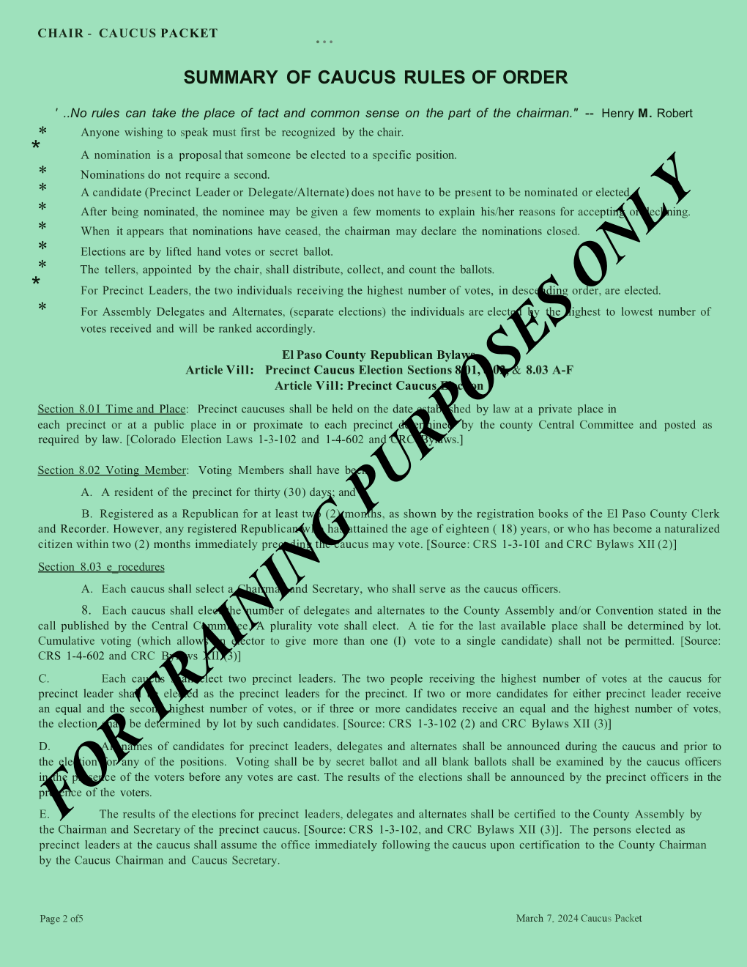
Summary of Robert’s Rules of Order and
El Paso County By-laws Article VI D regarding running of a caucus, page 2

Slide 5
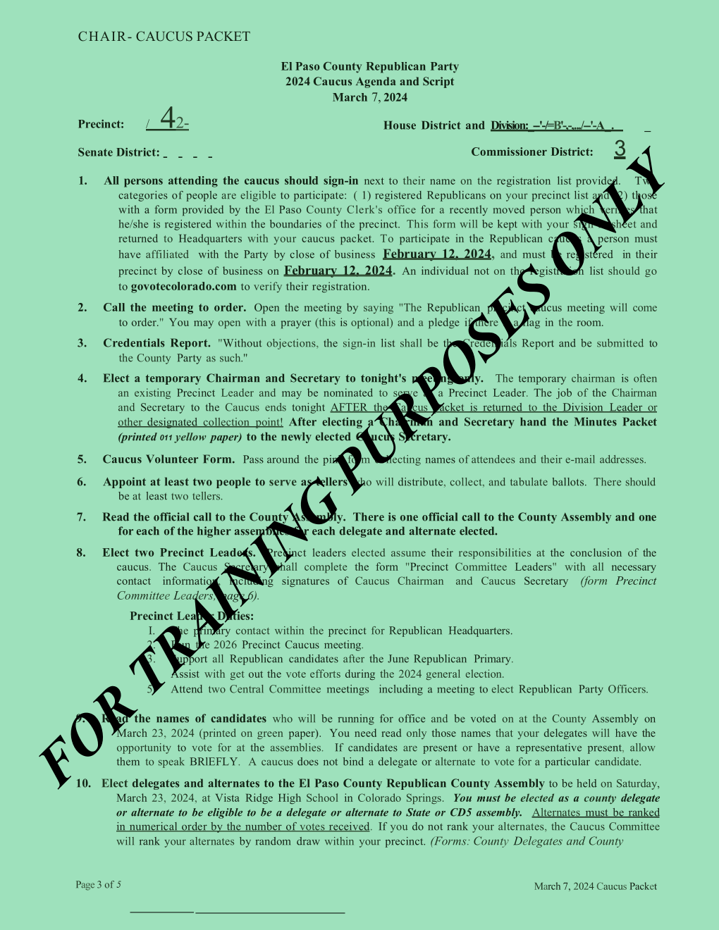
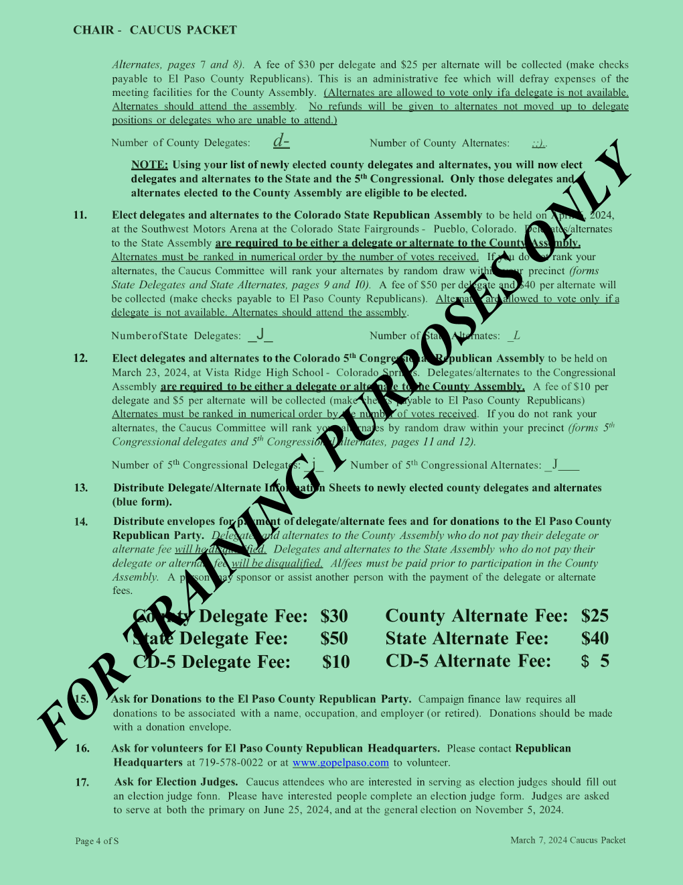
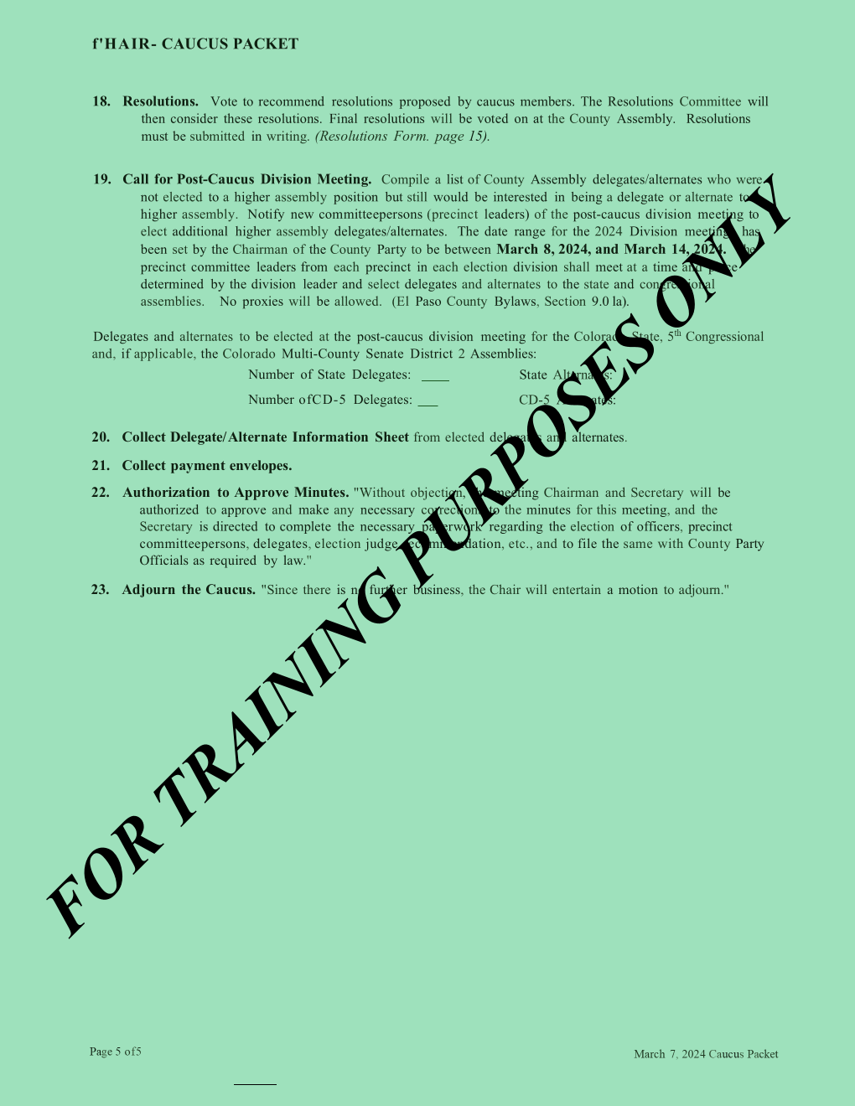
Agenda for Caucus Chairperson
(Pages 3 – 5)

Slide 6
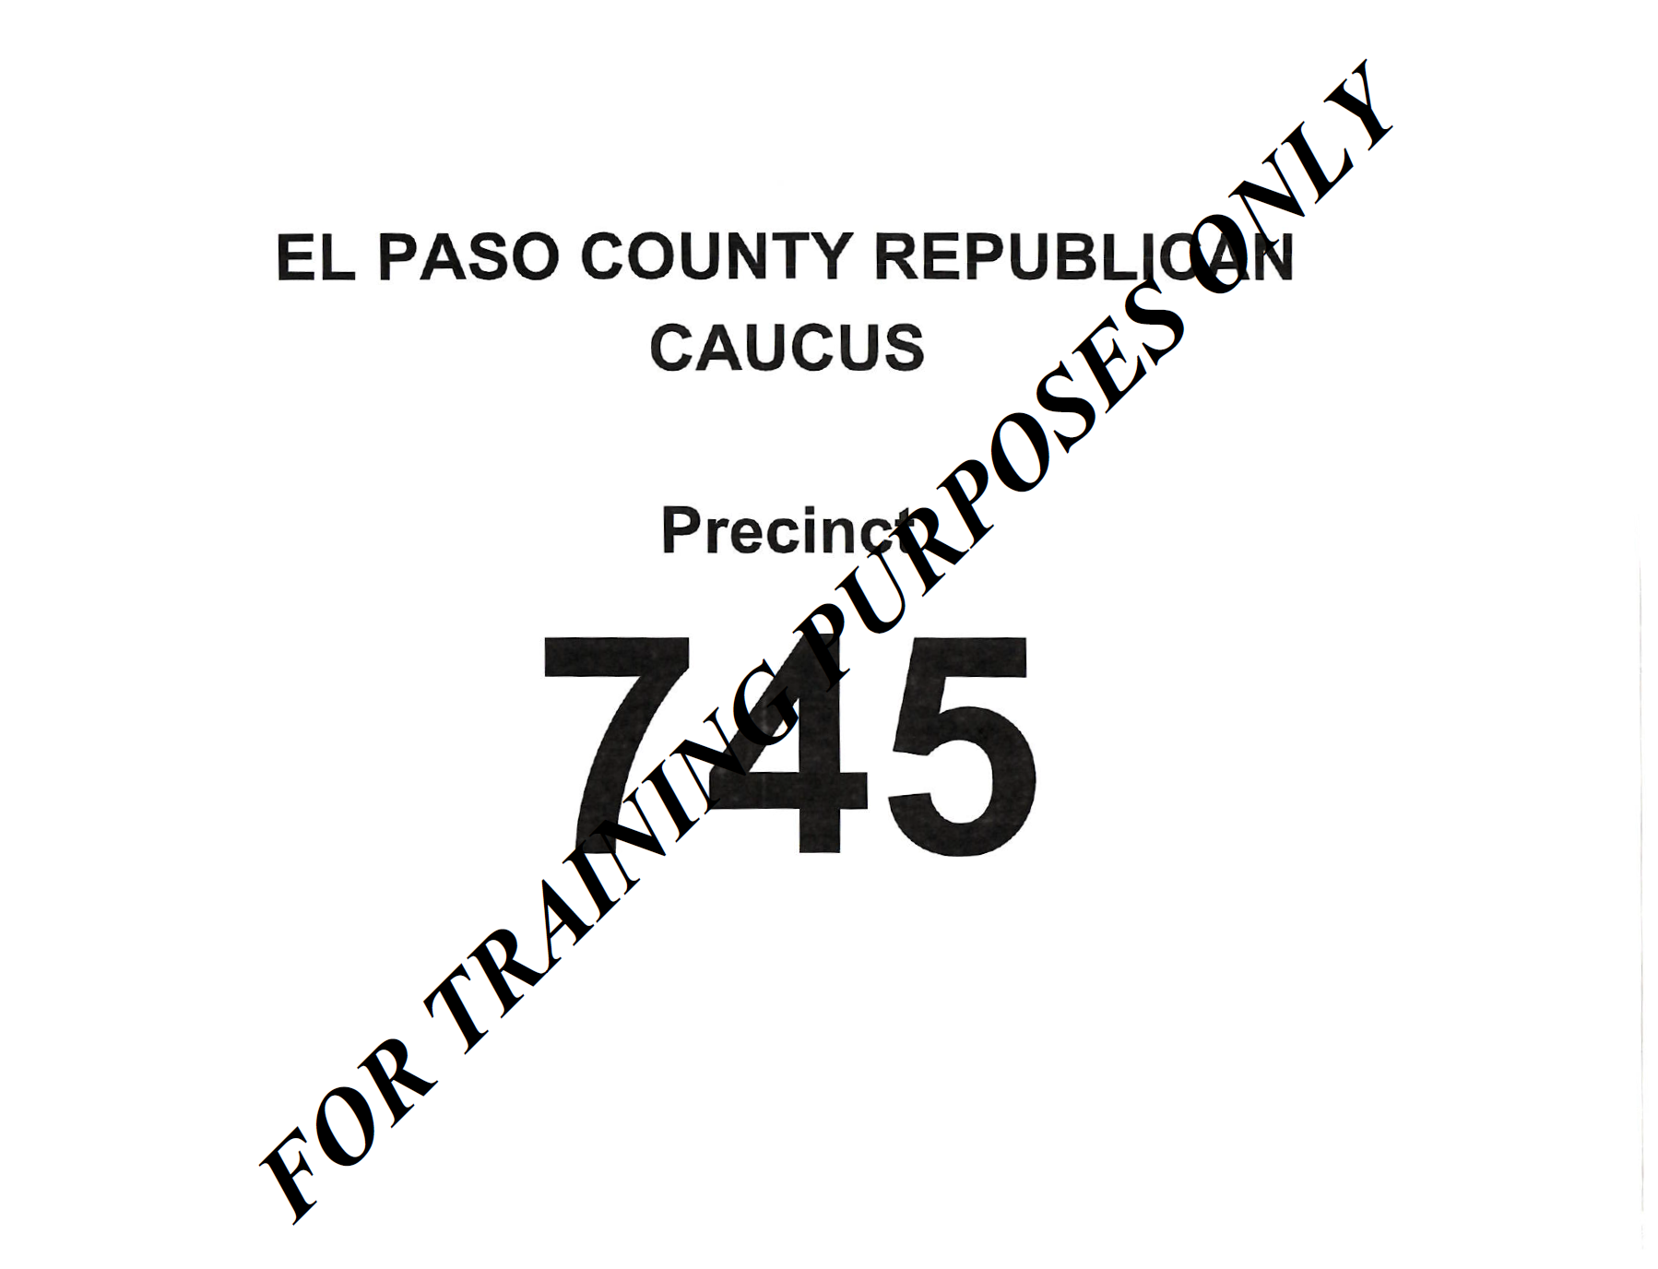
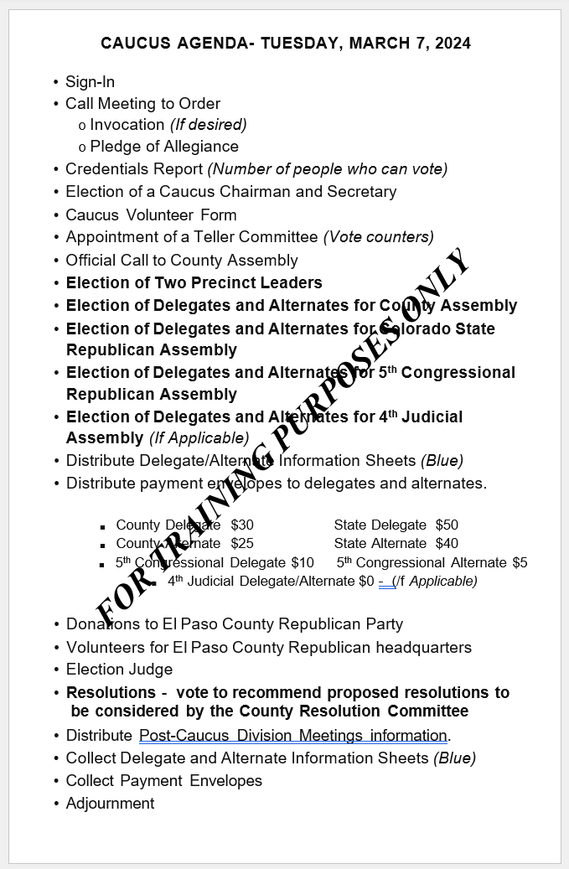
Caucus Signs

Slide 7
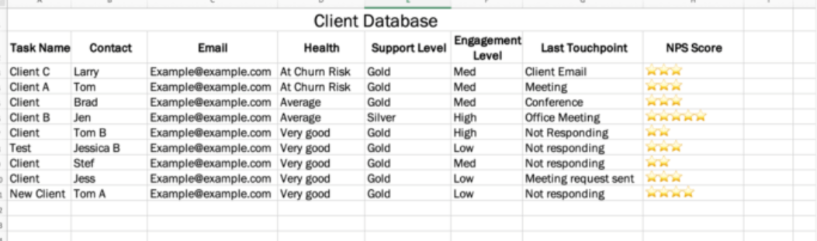
List of all registered Republicans within your precinct eligible to participate in the caucus.

Slide 8
Precinct Caucus
Sign in Sheet

Slide 9
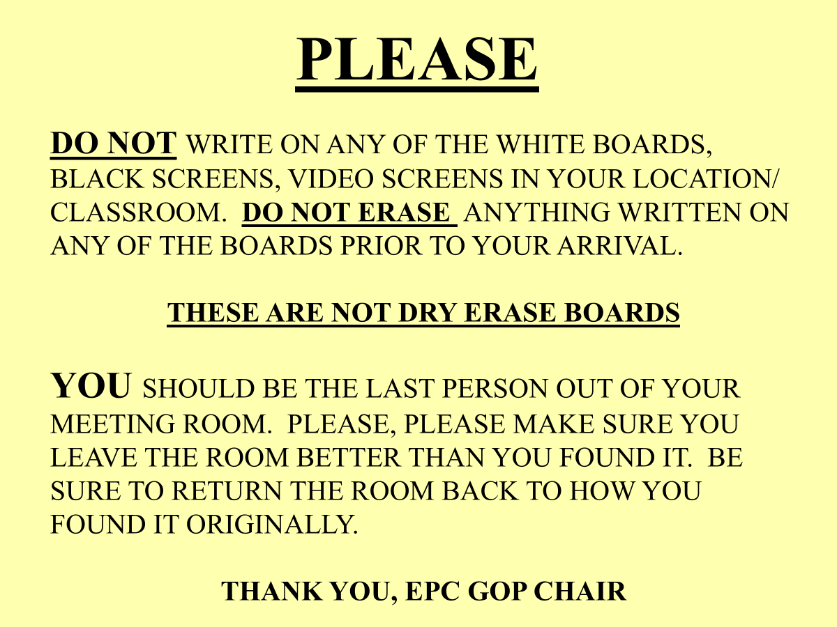
Memo for Precinct Leaders.

Slide 10
List of Republican Candidates

Slide 11
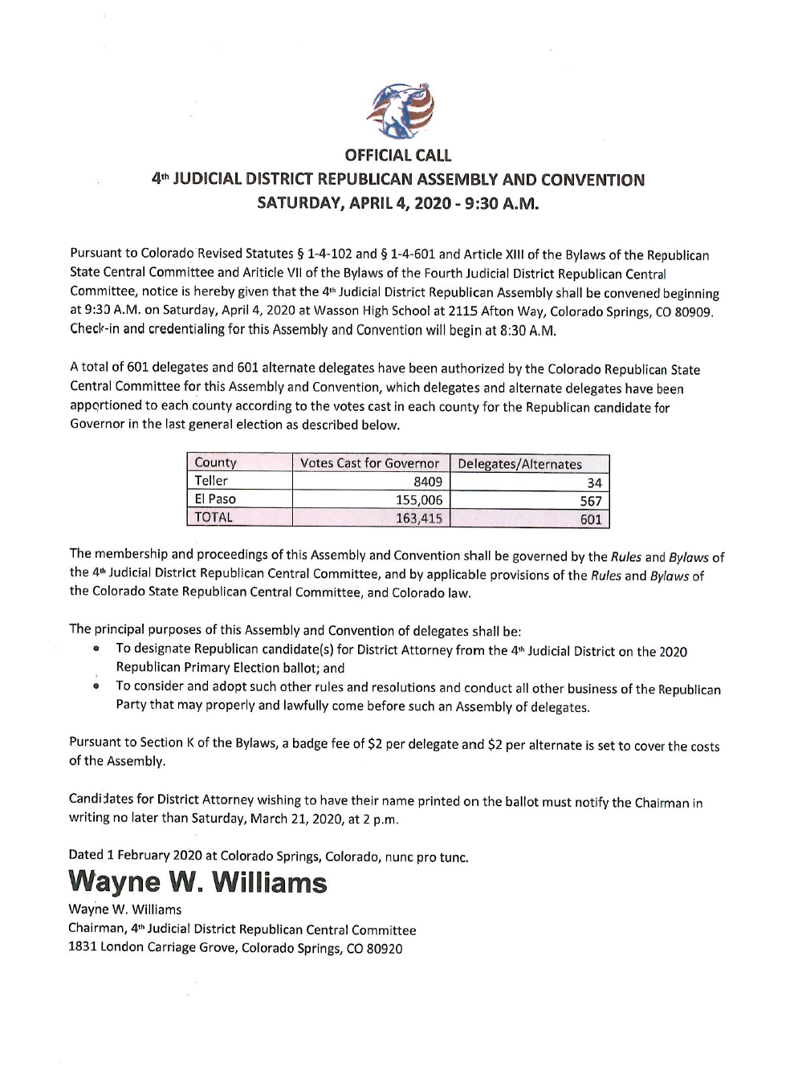
Official Call to Assemblies

Slide 12
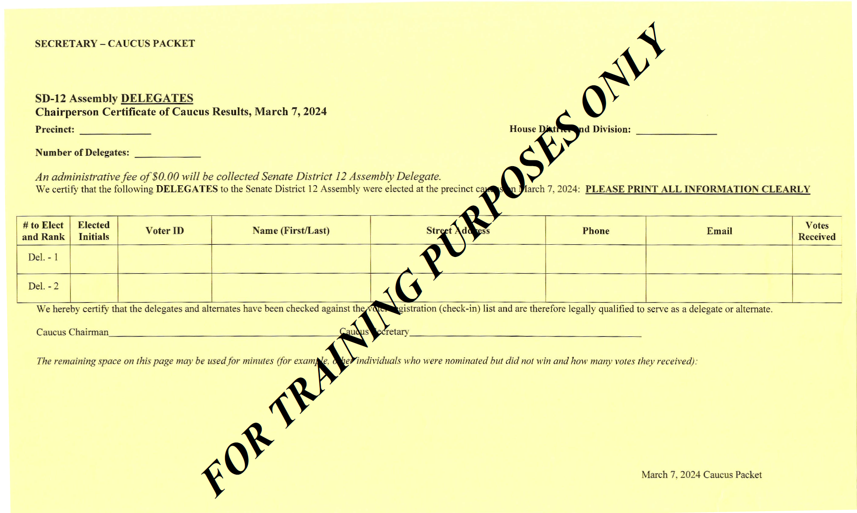
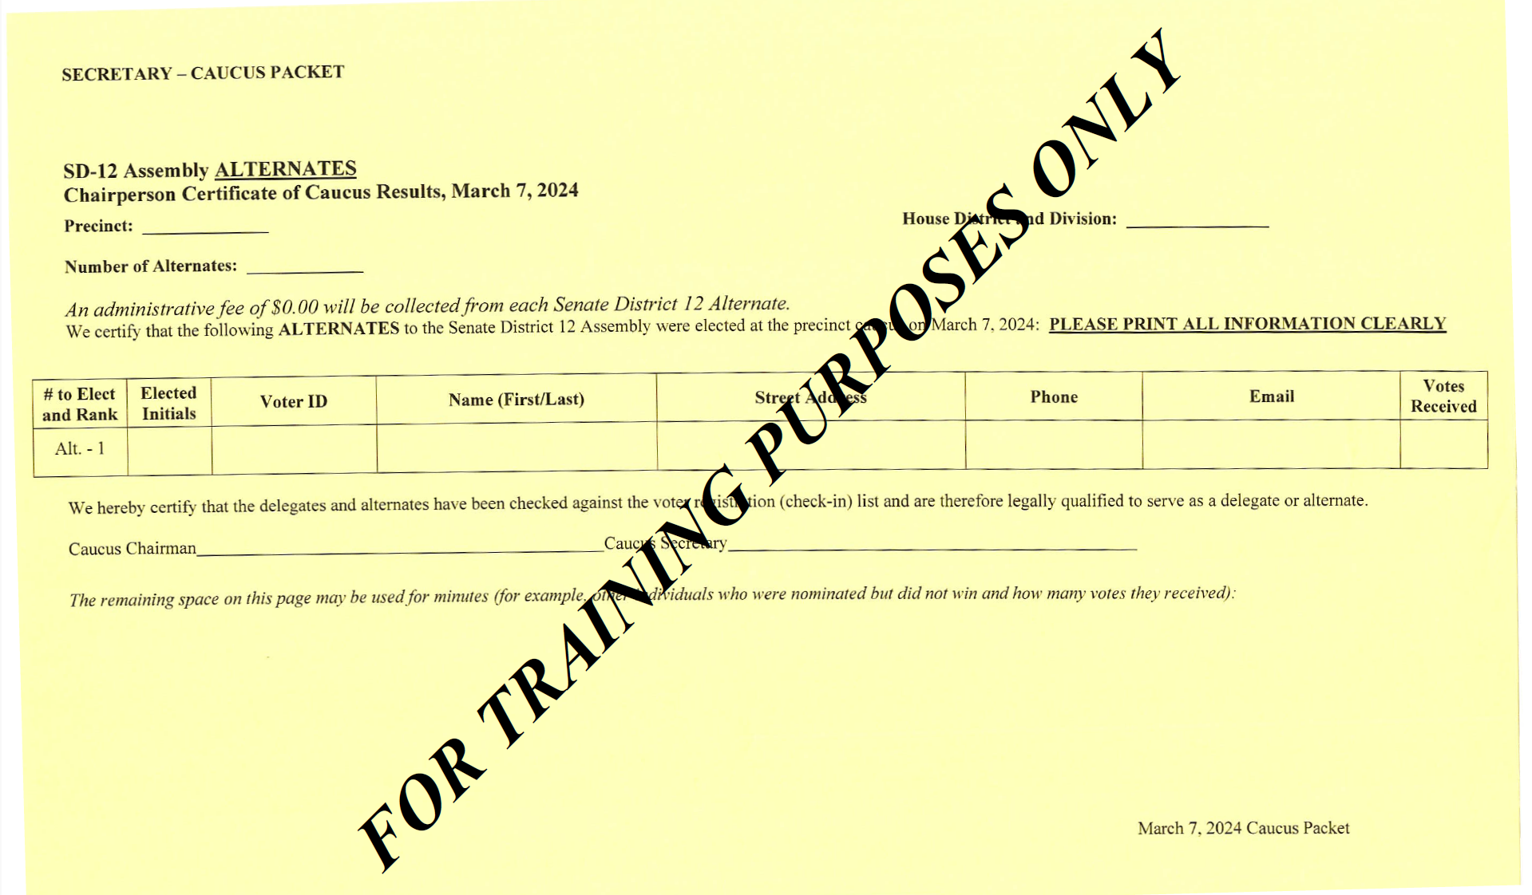
Certificates of Election

Slide 13
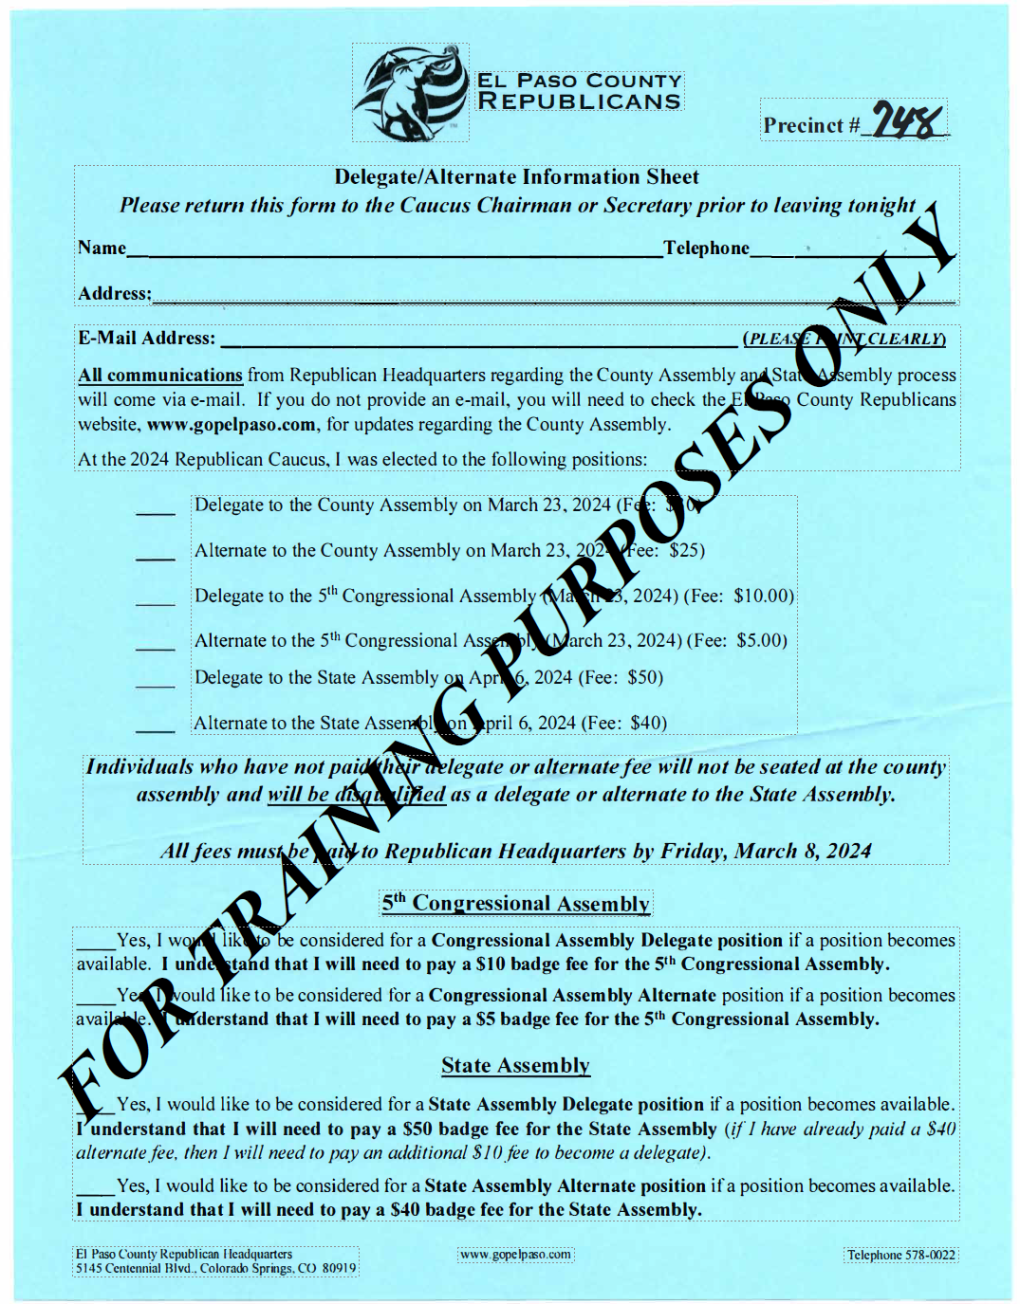
Delegate and Alternate Information Sheet

Slide 14
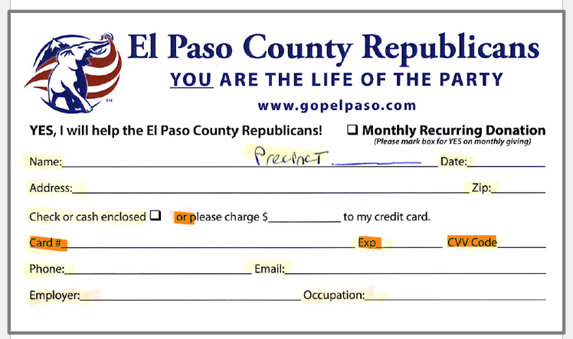
Money envelope
Used to collect delegate and alternate fees and
donations for the party.
If paying by check, make check out to:
El Paso County Republican Party
If paying in cash per finance law, we cannot
accept amount exceeding $100. Have the
individual fill out two envelopes and split
the amount.

Slide 15
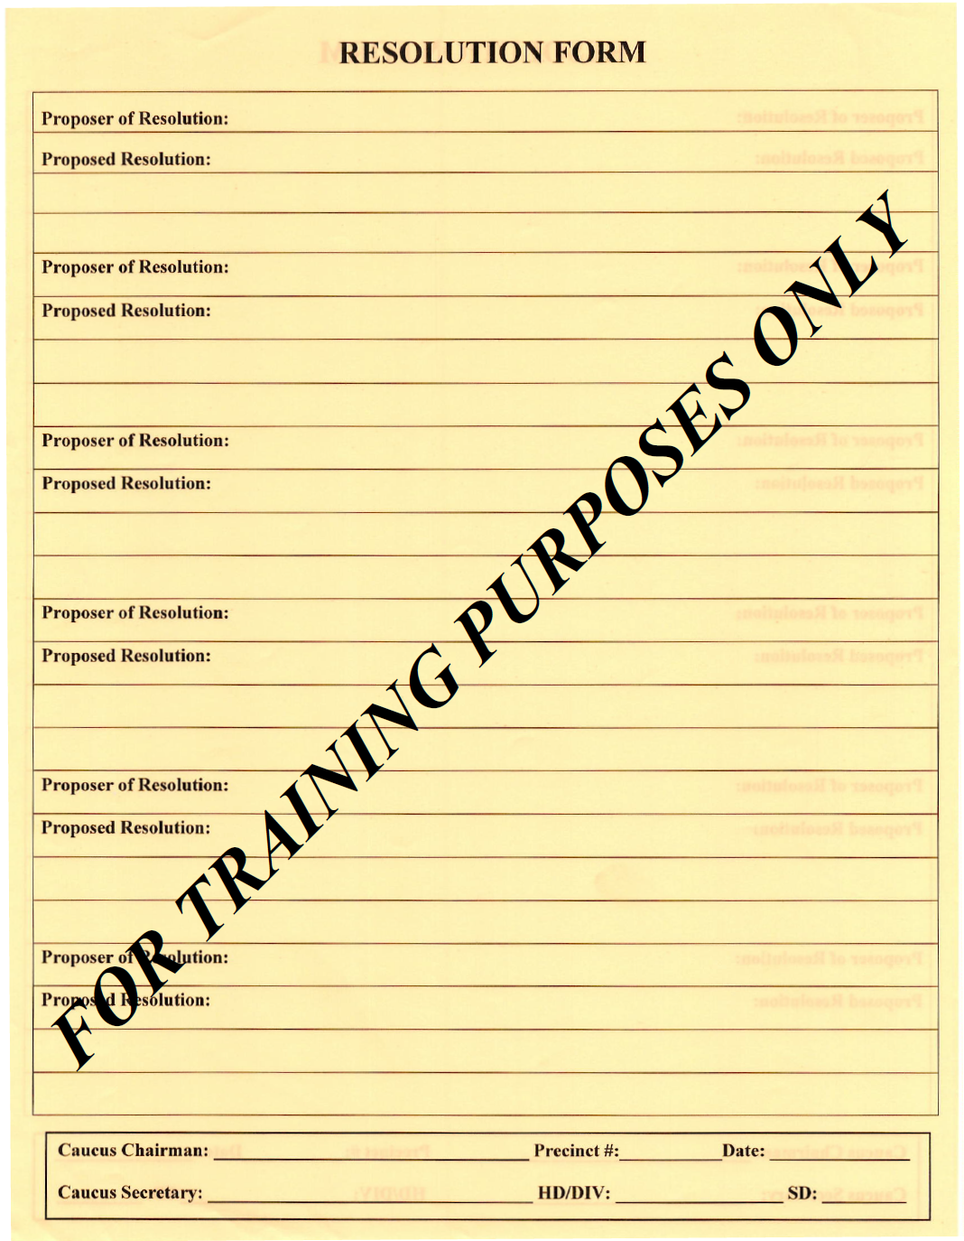
Resolutions

Slide 16
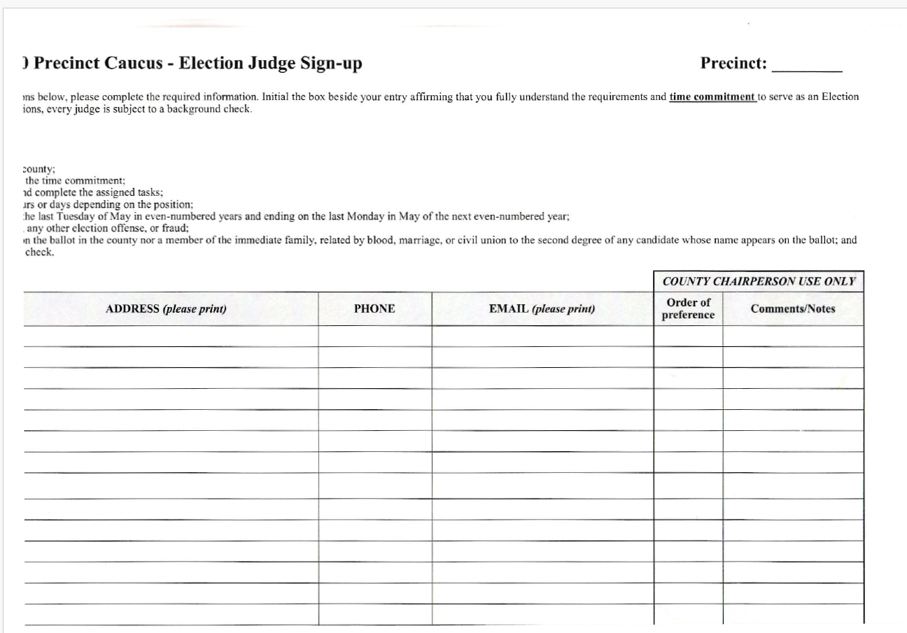
Judges Form

Slide 17
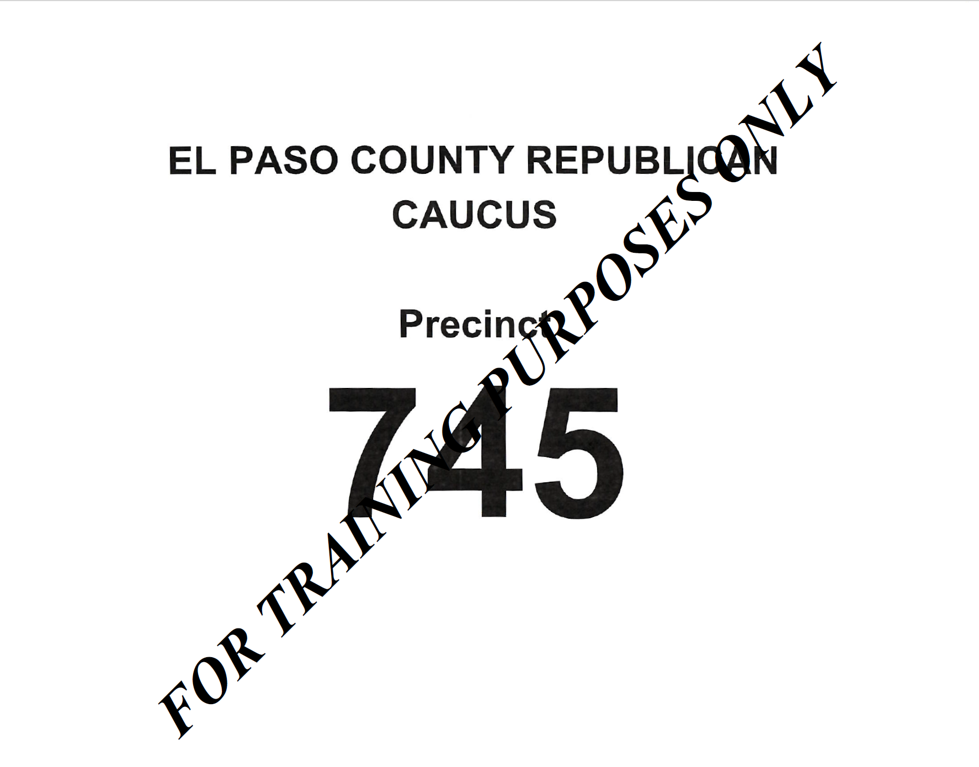

Set up Precinct Caucus Meeting Room/Area
Post Precinct Number on visible surface (door, wall, etc.).
Post Precinct Caucus Meeting Agenda.
Post signs with your precinct number on it that you can draw an arrow on throughout the building to direct people to the room you are in.
To
Precinct 745
Meeting Room/Area
(USE ONLY BLUE PAINTERS TAPE TO POST SIGNS)

Slide 18
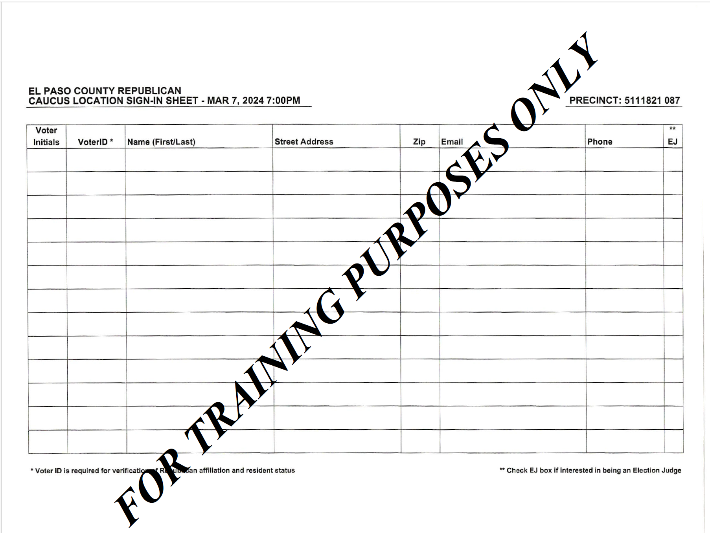





Set up Precinct Caucus Meeting Room/Area
Set out the Precinct Caucus Sign-in sheet.
Set out the black or blue ink pens.
Tape sheets of jumbo kraft paper to board or wall with blue painter’s tape.
Set out self adhesive name tags.

Slide 19
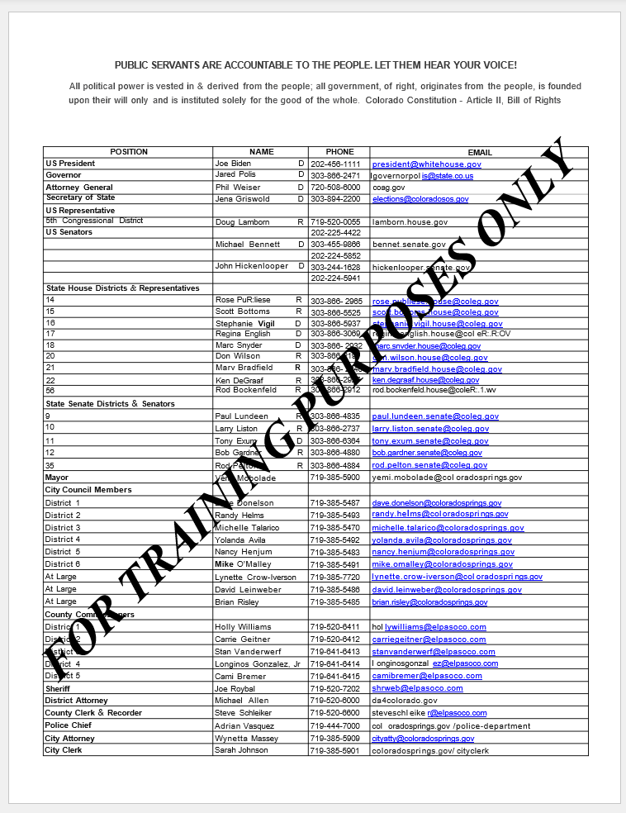
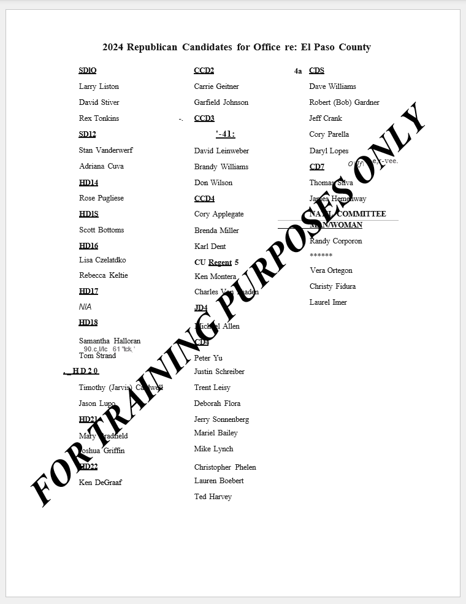
Set up Precinct Caucus Meeting Room/Area
Display the public servants contact information list and El Paso County Republicans for office document.
Write on Kraft paper or dry erase board the number of delegates and alternates to
be elected, cost if applicable and meeting
date.

Slide 20
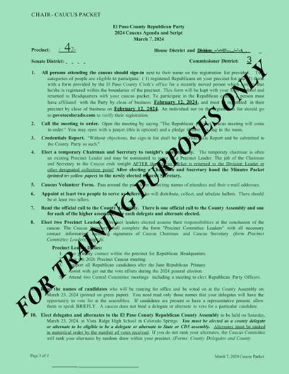
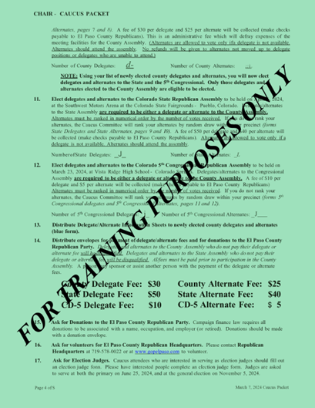
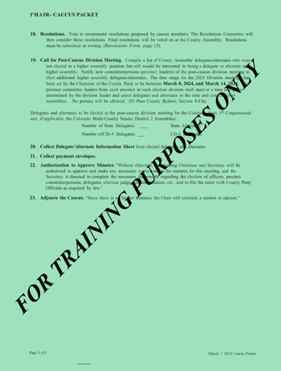
Follow agenda/script, pages 3 – 5 of the green packet to conduct your Precinct Caucus meeting.

Slide 21
Credentialing
Start by asking for an ID.
Using the provided list of all registered
Republicans eligible to vote in your precinct
verify and confirm eligibility.
Have the voter sign in. NOTE: Guest may
sign in but are not eligible to vote.
Prepare a name tag for the eligible voter.
Write the persons first and last name.
NOTE: Guest receive a completely different
name tag and are not eligible to vote.

Slide 22
Caucus chair should go over the expectations and responsibilities. Using the previously prepared chart state the position the individual would be running for (i.e., Precinct Leader) or the delegate
and alternate assembly the individual
would be running for (i.e., County
Assemble). How many elected positions
have been allocated for the precinct,
when the assemblies will be held, (date
and time) and the fee to be collected if
any from the elected delegate and
alternate.
NOTE: To be a Delegate for a candidate at Multi-county or State Assemblies/Convention, you MUST be a delegate at the County Assembly/Convention.
Before
Voting
and Accepting Nominations

Slide 23
Nominations
The Caucus chair opens up floor nominations.
The individual accepts or declines.
Names of individuals who accept their nomination is written on the Kraft paper.

Slide 24
Speech
The Caucus chair allows each candidate to speak for two minutes.

Slide 25

The Caucus chair appoints at a minimum two precinct members to act as the teller
committee.
The Caucus chair will go over the voting procedures, state what is being currently
voted on and who the candidates are.
The Caucus chair will instruct the teller committee to distribute the ballots. NOTE: Teller committee members will only distribute ballots to those members present that have been properly credentialed and verified to vote in the precinct they are attending. Individuals identified as visitors are not allowed to vote and will not receive a ballot.
Precinct Caucus members are given a
few minutes to vote.
Teller committee members collect the
ballots, count the votes for each
candidate and post the results on the
Kraft paper where the candidate names
had been previously written.
The Caucus chair announces the results.
Designated Caucus secretary begins to prepare the appropriate Certificate of Election.
Repeat this process for each election.
Voting

